Slide 1
Oxygen Therapy
Dr. Moustafa Al-Shammari

Slide 2
Learning Objectives
By the end of this chapter, the student nurse will be able to:
Define oxygen therapy.
List the purposes of oxygen therapy.
Identify indications of oxygen therapy.
List methods of oxygen therapy.
Describe the equipment required.
Perform appropriate techniques for each method.

Slide 3
Introduction
Oxygen is an essential body requirement for any energy consumption, activity or function. Hypoxemia resulting from apnea or inadequate ventilation and it occurs more rapidly in children than in adults because of children's higher metabolic rate and increase oxygen consumption.
Oxygen therapy is a treatment for acute or chronic respiratory conditions or ventilation failure, often lifesaving.

Slide 4
Purposes
Prevent hypoxemia.
Ensure tissue oxygenation in conditions such as:
  Reduced oxygen-carrying capacity (e.g., anemia).
  Decreased cardiac output.
  Increased metabolism.

Slide 5
Indications
Oxygen therapy is indicated in:
Decreased environmental oxygen (e.g., inhalation of non-physical gas mixtures).
Impaired alveolar ventilation (e.g., severe airway obstruction or lung pathology).
Decreased oxygen-carrying capacity (e.g., acute anemia).
Abnormal pulmonary blood flow: (Persistent fetal circulation, Acute pulmonary hypertension)
Poor tissue perfusion (e.g., shock states).
Acute brain insults (e.g., increased intracranial pressure).

Slide 6
Types of Oxygen Therapy
High Flow Rate:
13-15L/min, 60-80%.
Methods: Tent, Ambo bag.
Low Flow Rate:
1-13L/min, 40-60%.
Methods: Nasal cannula, face mask, etc.

Slide 7
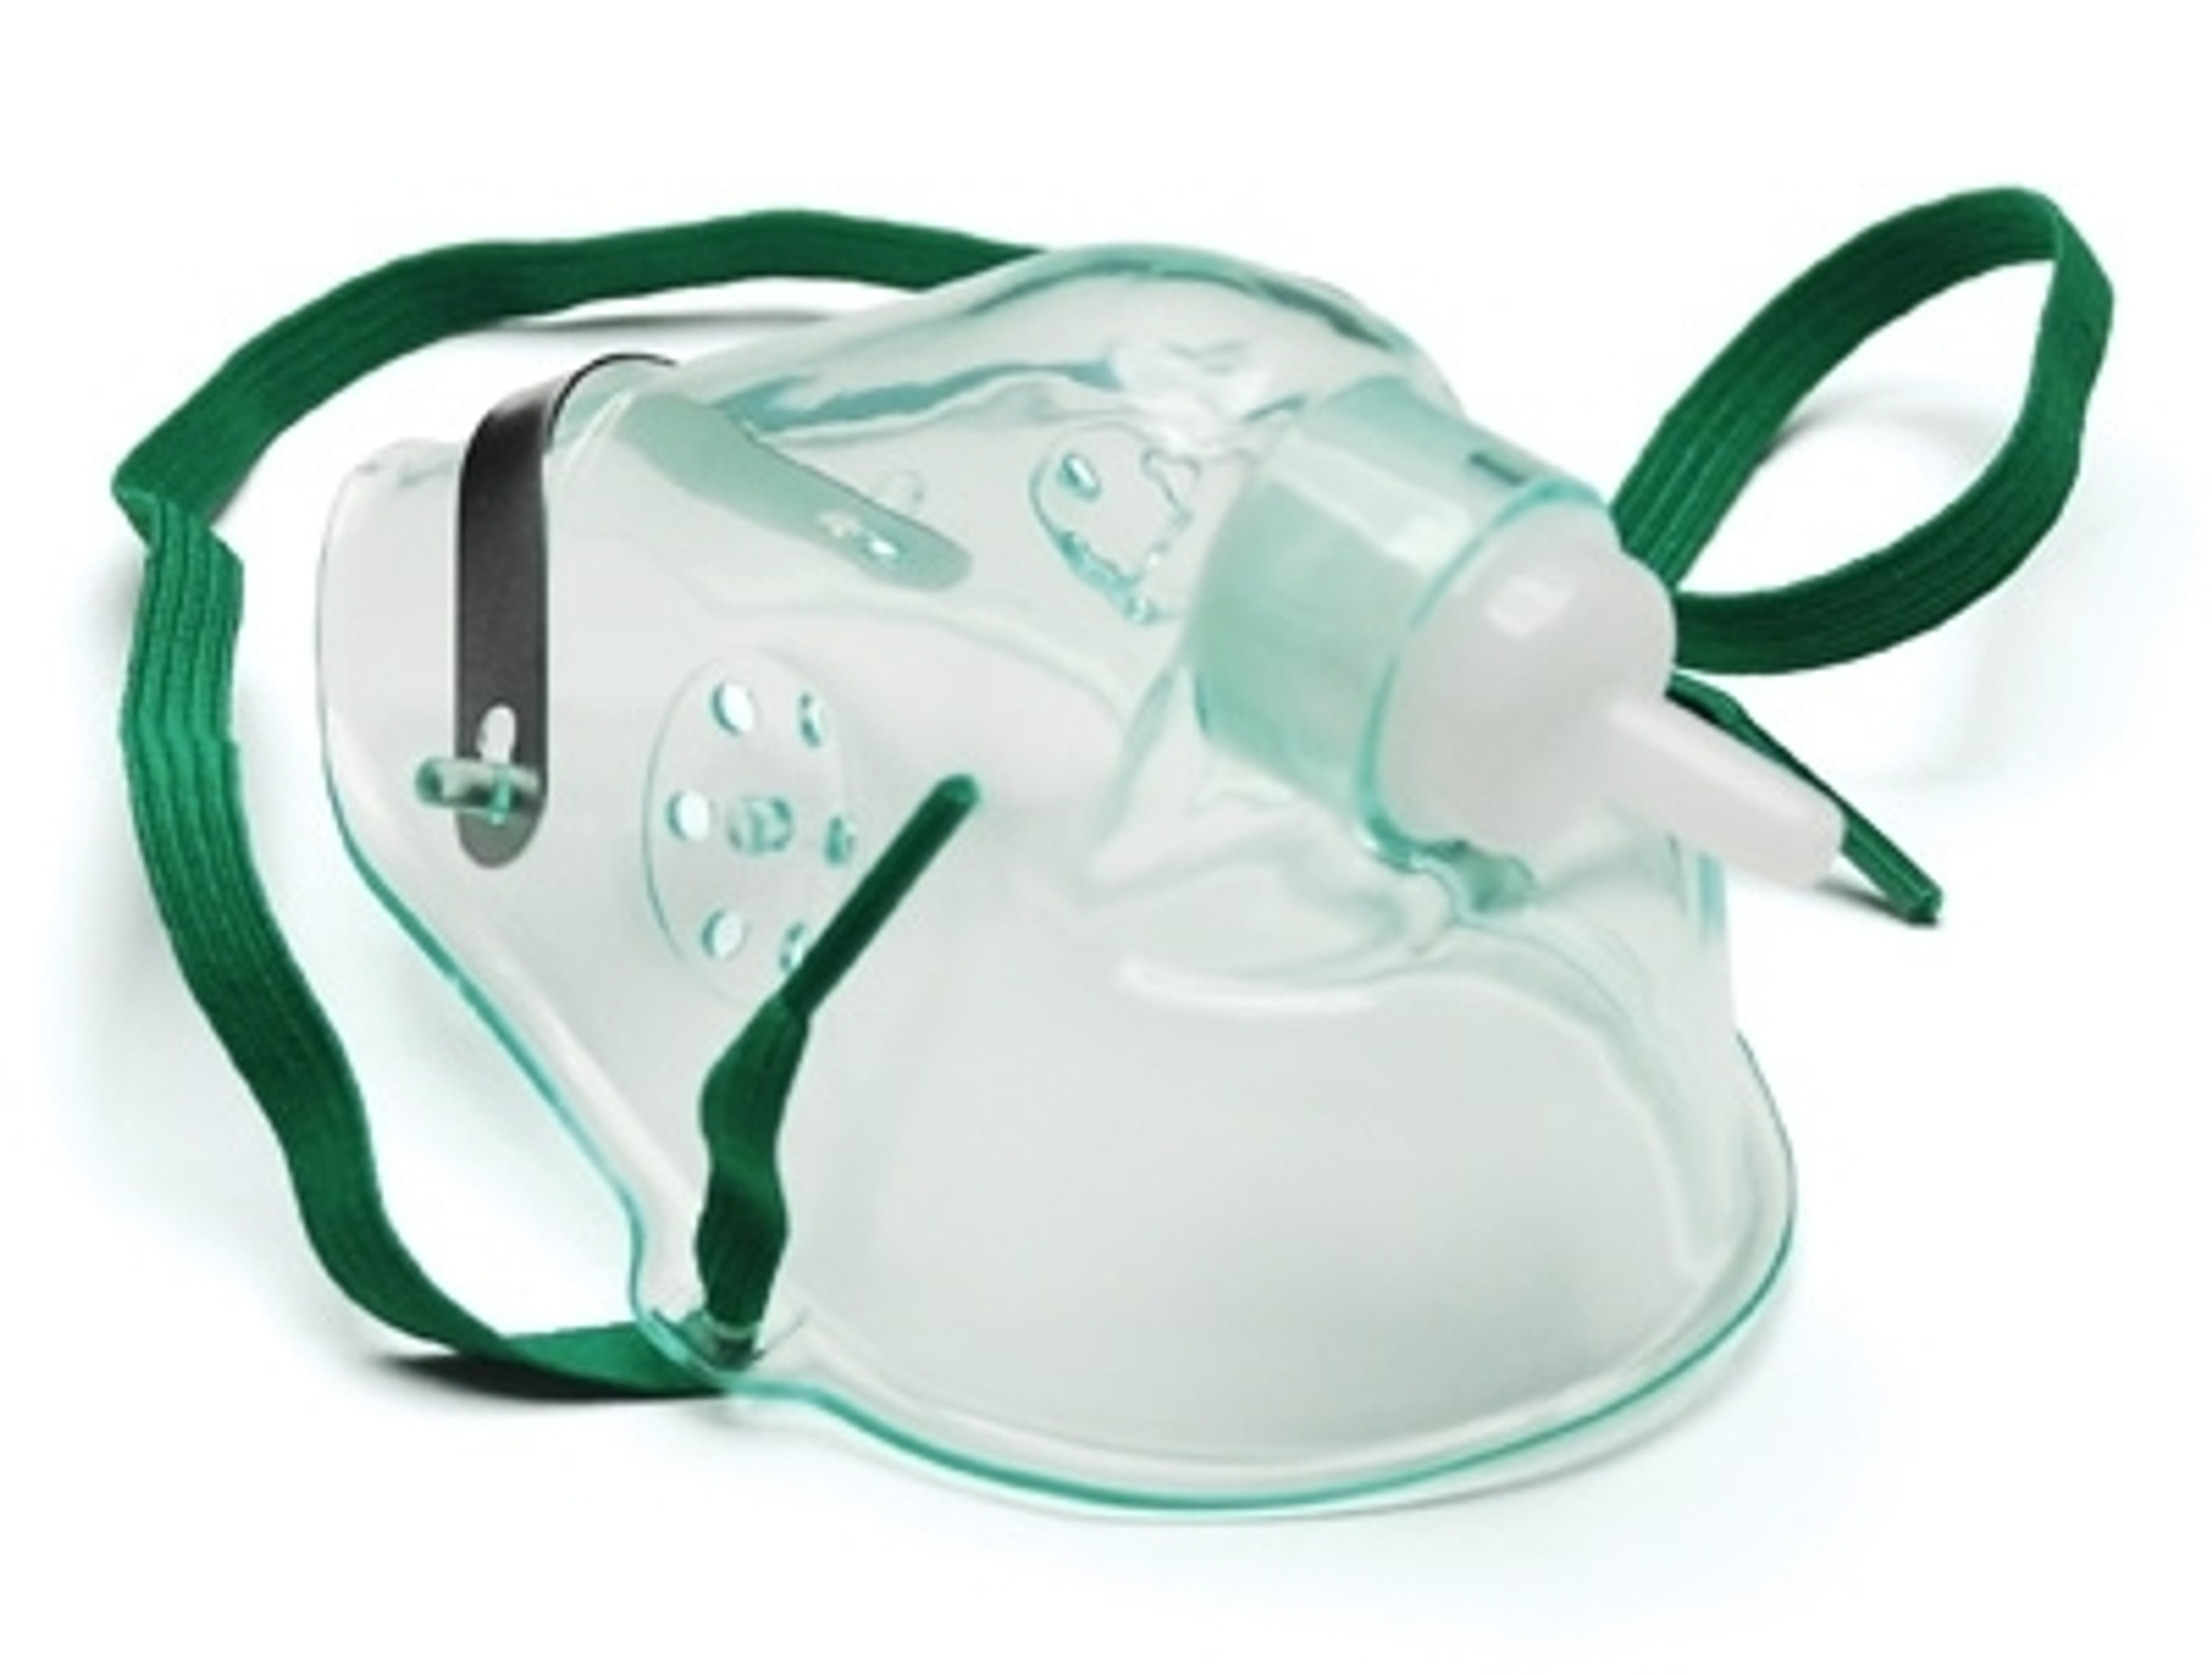
Methods
1. Simple Face Mask
Advantages:
  Variety of Sizes: Available in various sizes to fit different ages and facial structures.
  Universal Fit: Suitable for all age groups.
  Oxygen Flow Rate: Can deliver an oxygen flow rate of 5-10 L/min.
  Predictable Concentration: Delivers a consistent oxygen concentration even if the child breathes through the nose or mouth.
Disadvantages:
  Tolerability: Some children may not tolerate wearing the mask.
  Short-Term Use: Not ideal for long-term oxygen therapy.
  Concentration Dependence: The effectiveness of oxygen delivery depends on how securely the mask fits.
  Disruptions: Activities such as eating or talking can disrupt the oxygen supply.

Slide 8
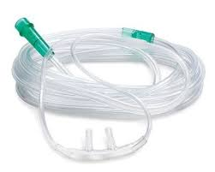
Methods
2. Nasal Cannula
Advantages:
  Age Versatility: Suitable for all age groups.
  Mobility: Allows the child considerable freedom of movement.
  Visual Field Uninterrupted: Does not obstruct the child's view.
  Constant O2 Flow: Provides continuous oxygen even when the child eats or talks.
  Flow Rate: Can deliver oxygen at a rate of 1-5 L/min.
Disadvantages:
  Resistance: Young children may resist wearing the cannula.
  Irritation: Can irritate the nasal mucosa.
  Restraint Need: May require restraining the child to keep it in place.
  Concentration Control: Difficult to control the oxygen concentration if the child breathes through the mouth.

Slide 9
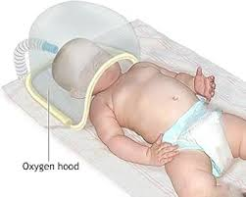
Methods
Head Box (Hood)
Advantages:
  Size Variety: Available in different sizes for different patient needs.
  Flow Rate: Maximum flow rate of up to 10 L/min.
  Unrestricted Movement: Does not limit facial or head movement.
Disadvantages:
  Limited Access: Makes it challenging to access the patient's head for examination or treatment.
  Humidity: Creates a high-humidity environment that can be uncomfortable.
  Interruption During Care: Must be removed during feeding and while providing patient care

Slide 10

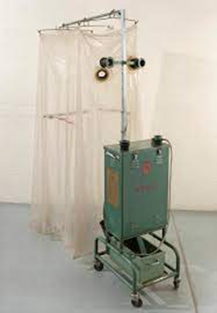
Methods
Mist tent
Advantages:
Tent allows older children considerable mobility.
Maximum flow rate (10L/m).
Disadvantages:
Steady O2 concentration difficult to maintain.
Child feel isolated.
Cool and wet tent environment.
Poor access to patient.

Slide 11
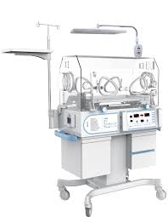
Methods
Incubator
Advantages:
  Neonatal Use: Suitable only for neonates and young infants.
  Mobility: Infant mobility is not restricted.
  Observation and Access: Allows easy observation and assessment of the infant and makes interventions straightforward.
Disadvantages:
  Oxygen Concentration Limitation: To achieve oxygen concentrations higher than 85%, an oxygen hood must be placed inside the incubator.

Slide 12
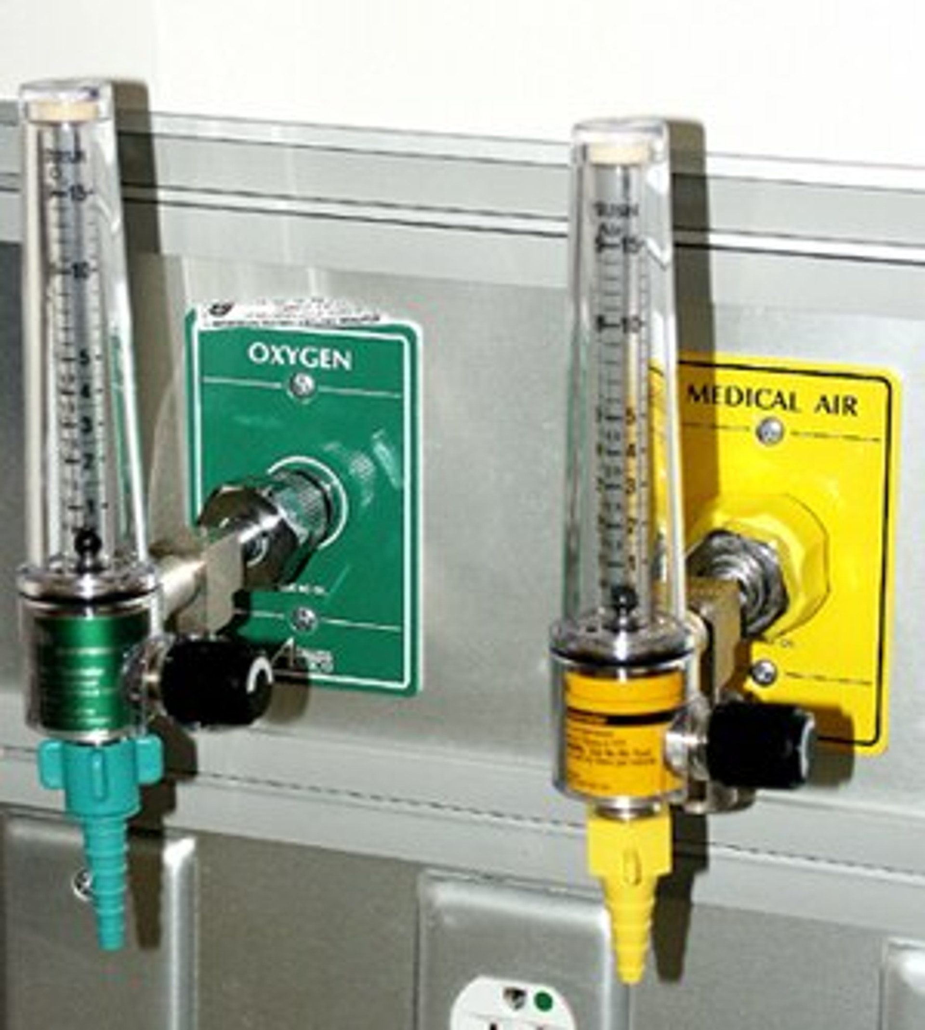
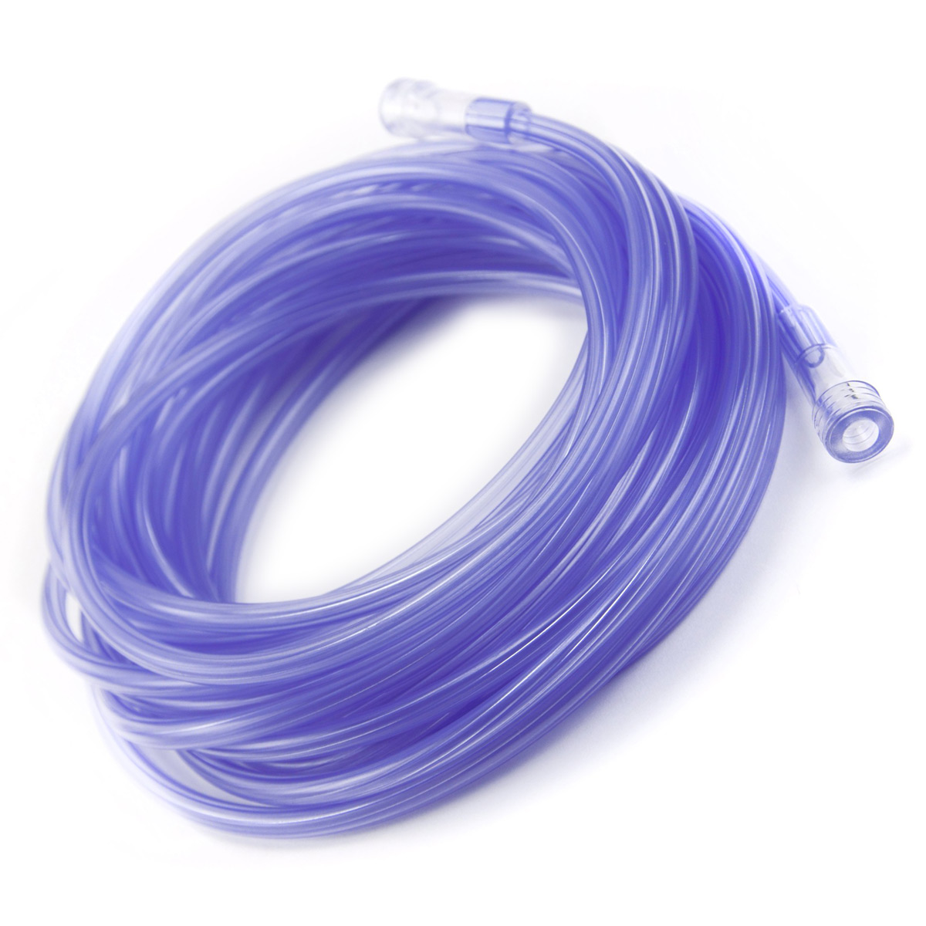
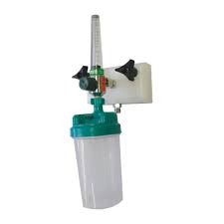
Equipment
. O2 source (cylinder or central piping system).
· Delivery equipment.
· Oxygen flowmeter.
· Oxygen tubing.
· Humidification attachment.
· Disposable gloves.
· Water soluble lubricant (for catheter insertion)

Slide 13
Humidification
Purpose of Humidification:
Prevents drying of respiratory mucosa.
Loosens secretions.
Prevents dehydration of mucous membranes.

Slide 14
Procedure for Oxygen Therapy
Perform hand hygiene.
Select appropriate equipment.
Ensure proper humidification to prevent dryness.
Use sterile water for bacterial prevention.
Attach and position the delivery device (e.g., cannula, mask, hood).
Monitor the oxygen flow and adjust as prescribed.
Evaluate the child’s response through SaO₂ levels or arterial blood gases.

Slide 15
Technique Notes
Specific Considerations:
For nasal cannula: Insert prongs properly and encourage nasal breathing.
For mask: Secure straps snugly.
For hood: Ensure comfort and avoid resting hood on the neck.

Slide 16
Evaluation of Response
Assess Effectiveness Through:
Pulse Oximeter (SaO2): Target above 90%.
Arterial Blood Gas (PaO2): Target above 90 mmHg.
Poor Response Indicators:
SaO2 under 85%.
PaO2 under 60 mmHg.

Slide 17

Complications
Retinopathy of prematurity(ROP).
Hypoventilation.
Absorption atelectasis.
Bronchopulmonary dysplasia.

Slide 18

THANK YOU

